Slide 1

Advanced C#

Slide 2
Learning Objectives
Understand Delegates and events in C#
Understand Unity’s Coroutines

Slide 3
Delegates
What is a Delegate?
A delegate is a type that represents a reference to a method. Think of it as a function pointer in C++. It allows you to pass methods as arguments to other methods, making your code more flexible and reusable.
There are three steps involved while working with delegates:
Declare a delegate
Create an instance and reference a method
Invoke a delegate

Slide 4
Delegates
Declaration of Delegates in C#

Slide 5


Delegates
Declaring a Delegate:
This declares a delegate named MyDelegate that takes a string as a parameter and returns void.
Assigning a Method to a Delegate
Invoking a Delegate:

Slide 6
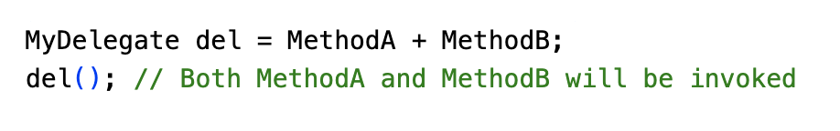
Delegates
Multicast Delegates:
A delegate can point to multiple methods. This is called a multicast delegate. You can add or remove methods from a multicast delegate using the + and - operators.

Slide 7
Delegates
Generic Delegates:
C# provides generic delegates like Action and Func for common scenarios:
Action<T>: Represents a method that takes an argument of type T and returns void.
Func<T, TResult>: Represents a method that takes an argument of type T and returns a value of typeTResult`.

Slide 8
Delegates
Use Cases:
Event Handling: Delegates are used to define event handlers.
Asynchronous Programming: Used in asynchronous operations like callbacks and asynchronous methods.
Callback Functions: Passing methods as arguments to other methods.
Customizing Behavior: Allowing clients to provide custom logic through delegates.

Slide 9
Delegates
Key Points:
Delegates are a powerful tool for creating flexible and reusable code.
They can be used to pass methods as arguments.
Multicast delegates allow multiple methods to be invoked in response to a single event.
Generic delegates provide a concise way to work with delegates of different types.z

Slide 10
Events in C#
What are Events?
Events are a notification mechanism in C# that allows objects to communicate with each other. Imagine a fire alarm system in a building. The alarm (event) triggers when smoke is detected (action occurred). Different parties (subscribers) like the fire department, building management, and occupants react accordingly.
The class who raises events is called Publisher, and the class who receives the notification is called Subscriber.

Slide 11
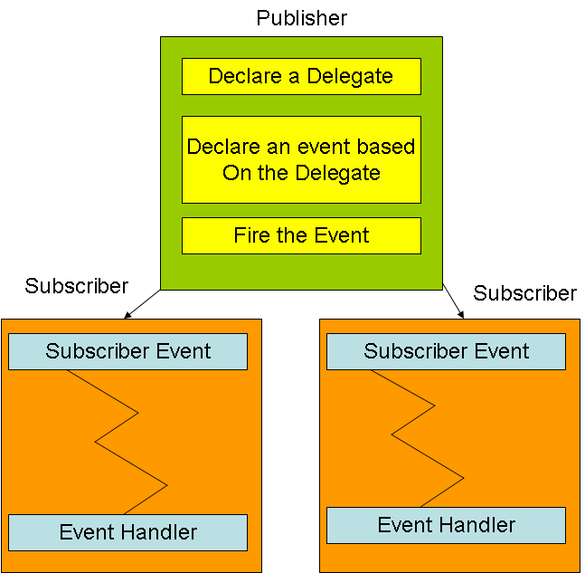
Events in C#
What are Events?
The class who raises events is called Publisher, and the class who receives the notification is called Subscriber.

Slide 12
Events in C#
Events and Delegates
Events are encapsulated delegates. A delegate defines the signature for the event handler method used by the subscriber class. This ensures compatibility between the publisher and subscriber.
Creating an Event:
Declare a delegate: This defines the method signature for the event handler.
Declare an event variable: Use the event keyword with the delegate type.

Slide 13
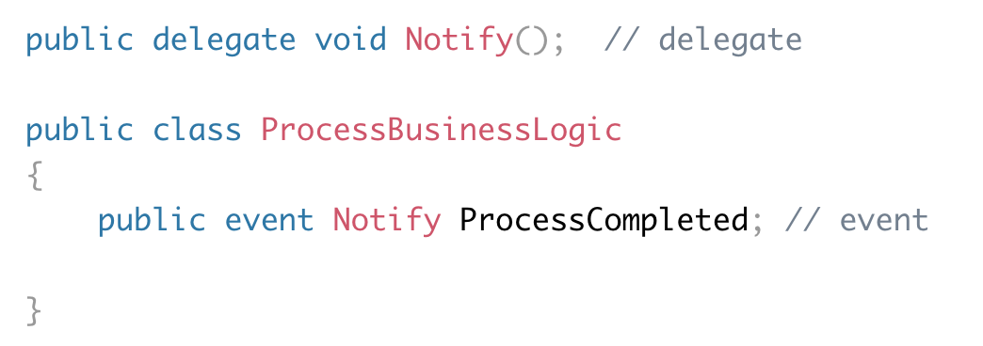
Events in C#
Example: Declaring an Event

Slide 14
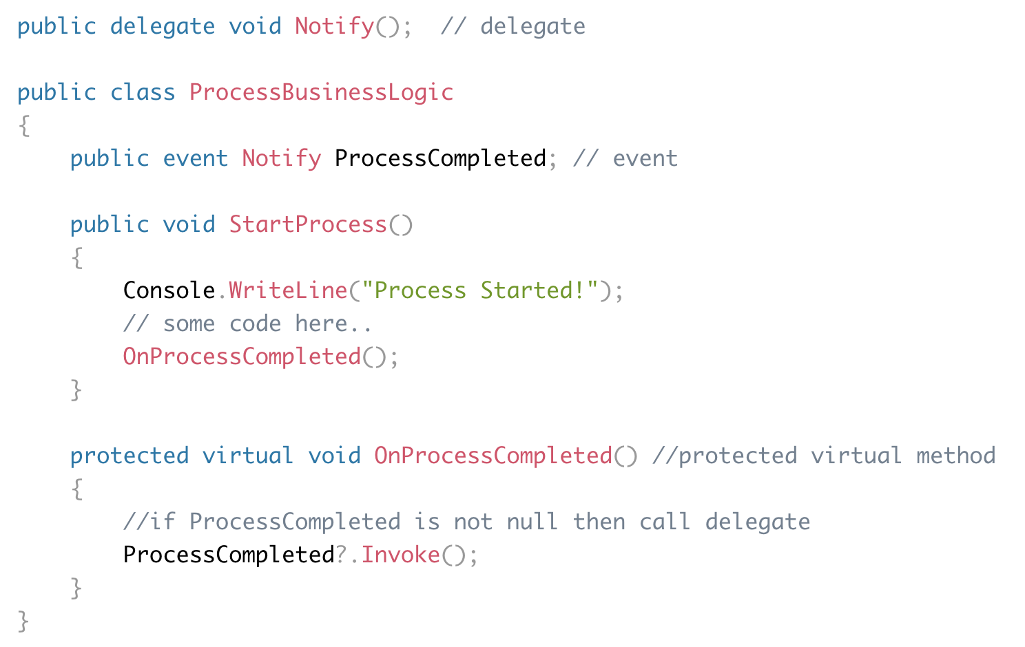
Events in C#
Example: Raising an Event

Slide 15
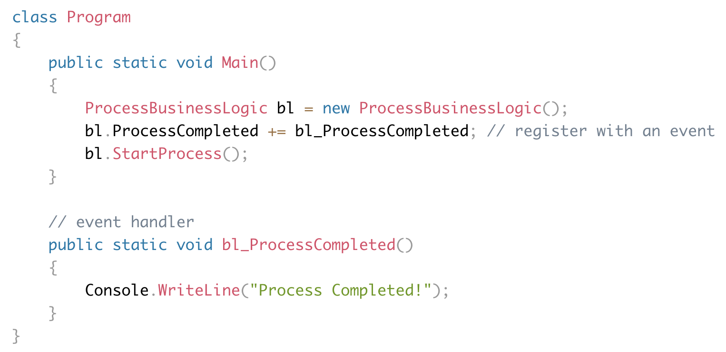
Events in C#
Example: Consume an Event

Slide 16
Events in C#
Raising an Event:
Protected Virtual Method: A protected virtual method named On<EventName> is typically used to raise an event. This allows derived classes to override the event-raising behavior while ensuring that the base class's event is also triggered.
Invoking the Delegate: The On<EventName> method uses the null-conditional operator (?.) to safely invoke the event. This ensures that the event is only raised if there are any subscribers.

Slide 17
Events in C#
Subscribing to an Event:
Registering: The subscriber class registers for the event using the += operator. This adds the subscriber's event handler method to the event's invocation list.
Handling the Event: The event handler method must have the same signature as the delegate associated with the event. When the event is raised, the event handler is invoked.

Slide 18
Events in C#
Built-in EventHandler Delegate
.NET Framework provides two built-in delegate types for common event scenarios:
EventHandler: Used for events that don't require additional data. It has two parameters:
sender: The object that raised the event.
e: An EventArgs object, which is often empty.
EventHandler<TEventArgs>: Used for events that need to pass additional data. It has two parameters:
sender: The object that raised the event.
e: An object of type TEventArgs, which contains the event-specific data.

Slide 19
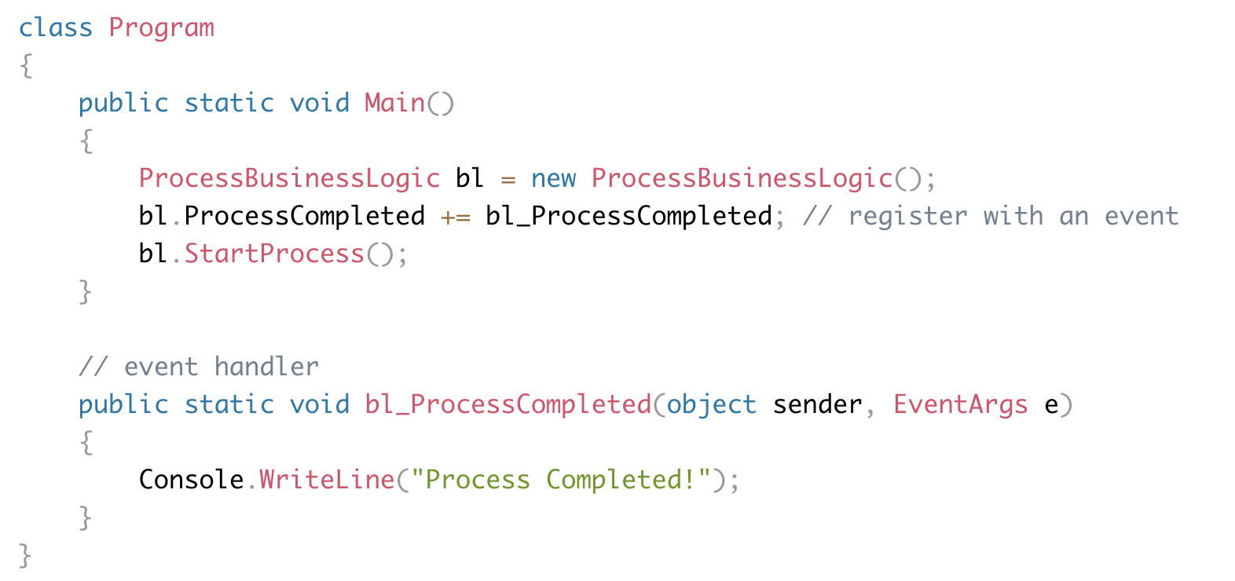
Events in C#
Example: EventHandler

Slide 20
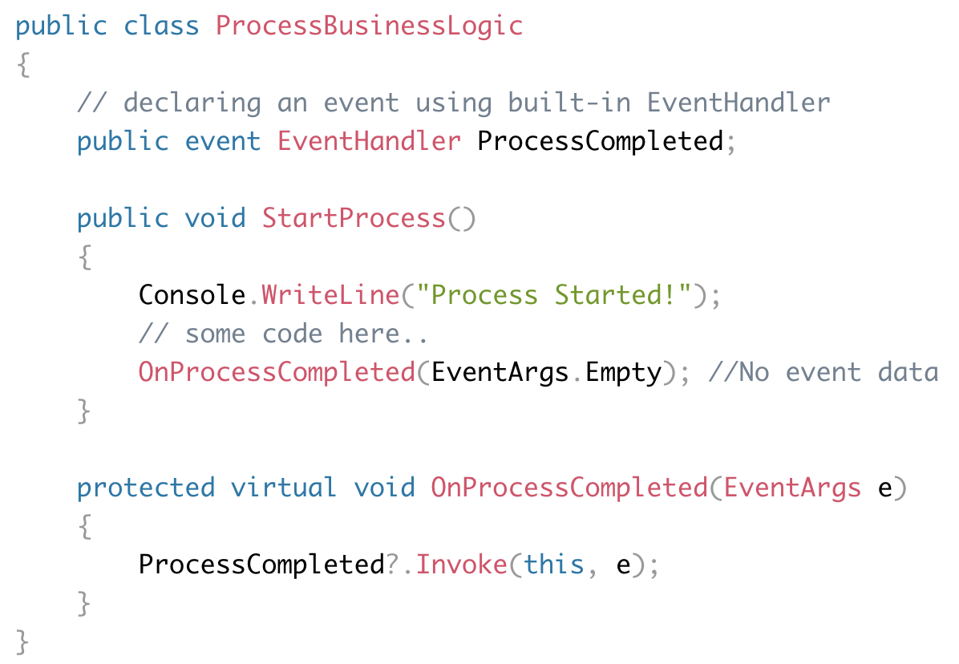
Events in C#
Example: EventHandler

Slide 21
Coroutines in Unity
What is a Coroutine?
A coroutine is a function that can pause its execution and resume later, allowing you to spread tasks across multiple frames. This is especially useful for time-based effects, asynchronous operations, and creating procedural animations.
References: https://docs.unity3d.com/2022.3/Documentation/Manual/Coroutines.html

Slide 22
Coroutines in Unity
Why Use Coroutines?
Time-Based Effects: Gradually fade objects in and out, animate objects over time, etc.
Asynchronous Operations: Handle long-running tasks without blocking the main thread (e.g., loading assets, network requests).
Procedural Animations: Create complex animations that can be easily paused, resumed, or modified.
References: https://docs.unity3d.com/2022.3/Documentation/Manual/Coroutines.html

Slide 23
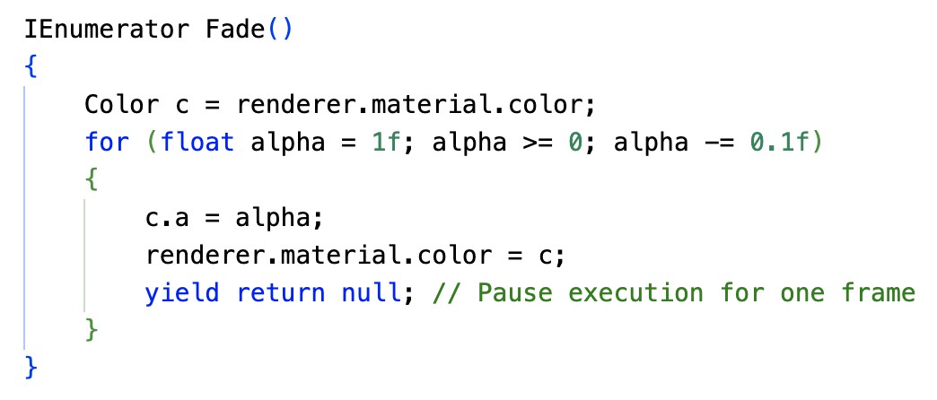
Coroutines in Unity
Declaring a Coroutine
To declare a coroutine, use the IEnumerator return type and the yield return statement:
References: https://docs.unity3d.com/2022.3/Documentation/Manual/Coroutines.html

Slide 24
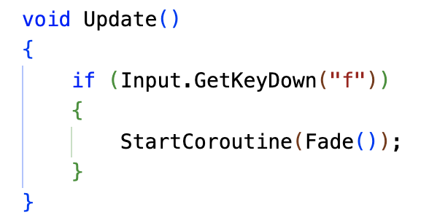
Coroutines in Unity
Starting a Coroutine
To start a coroutine, use the StartCoroutine method:
References: https://docs.unity3d.com/2022.3/Documentation/Manual/Coroutines.html

Slide 25
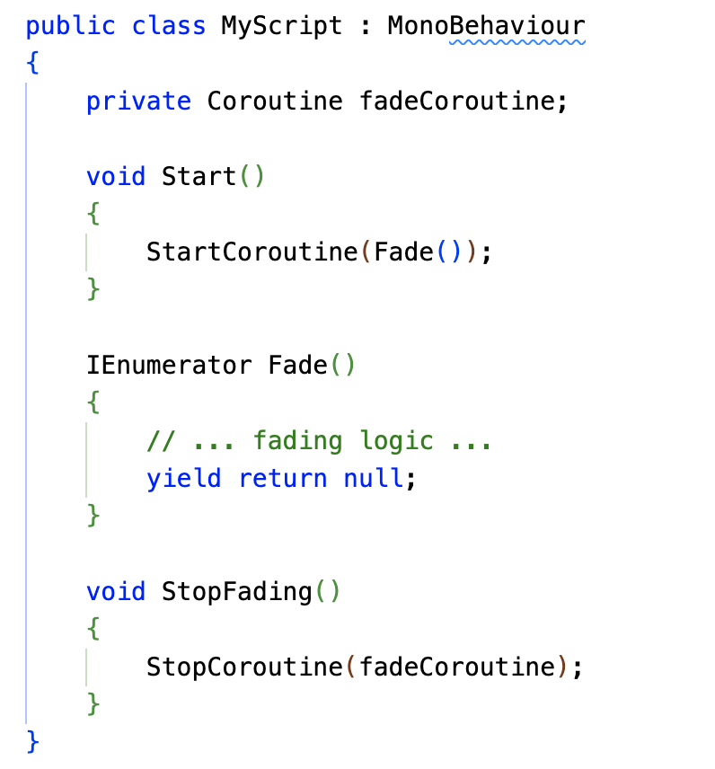
Coroutines in Unity
Stopping coroutines
To stop a coroutine, use StopCoroutine and StopAllCoroutines. A coroutine also stops if you’ve set SetActive to false to disable the GameObject the coroutine is attached to.
References: https://docs.unity3d.com/2022.3/Documentation/Manual/Coroutines.html

Slide 26
Recap
Delegates
A delegate is a type that represents a reference to a method.
It allows you to pass methods as arguments to other methods.
Key steps: declare, assign, and invoke.
Events
A notification mechanism that allows objects to communicate.
A publisher raises an event, and subscribers can register to receive notifications.
Events are built upon delegates.

Slide 27
Recap
Coroutines
A function that can pause its execution and resume later.
Useful for time-based effects, asynchronous operations, and procedural animations.
Use yield return null to pause for a frame, yield return new WaitForSeconds(time) to pause for a specific time.

